Slide 1
Computer Organization & Assembly Language (CSC-205)
Lecture 3

Slide 2
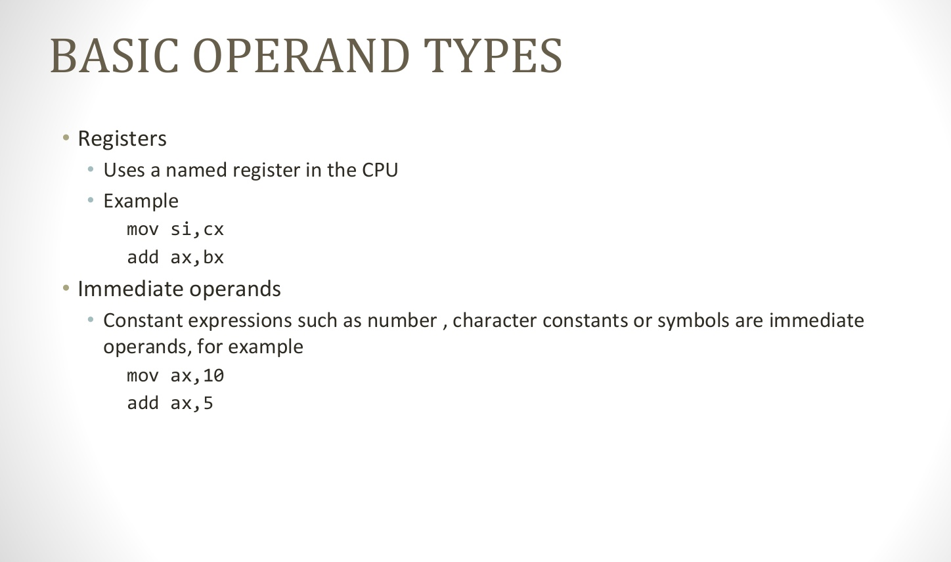
BASIC OPERAND TYPES

Slide 3
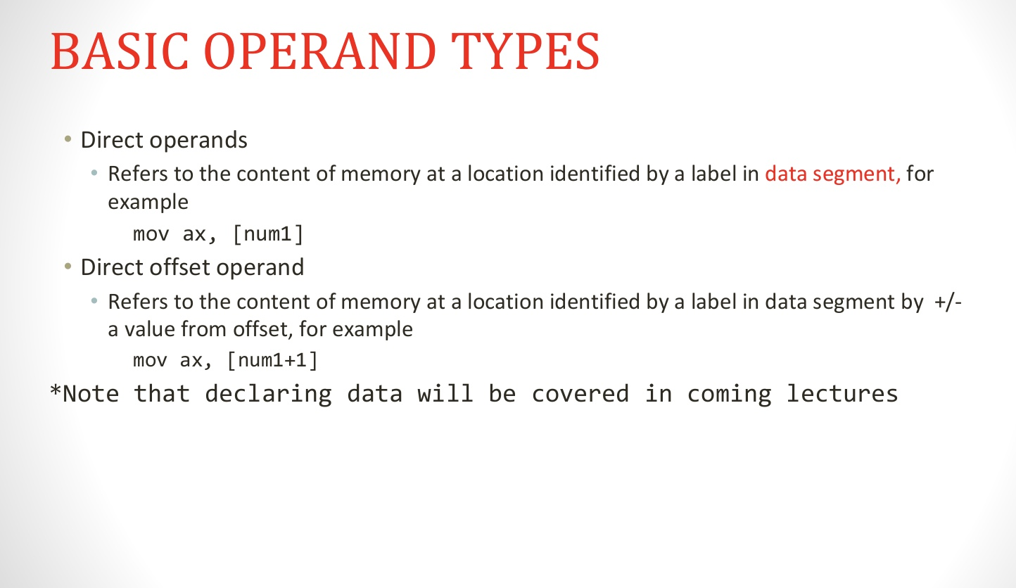
BASIC OPERAND TYPES

Slide 4

Memory

Slide 5
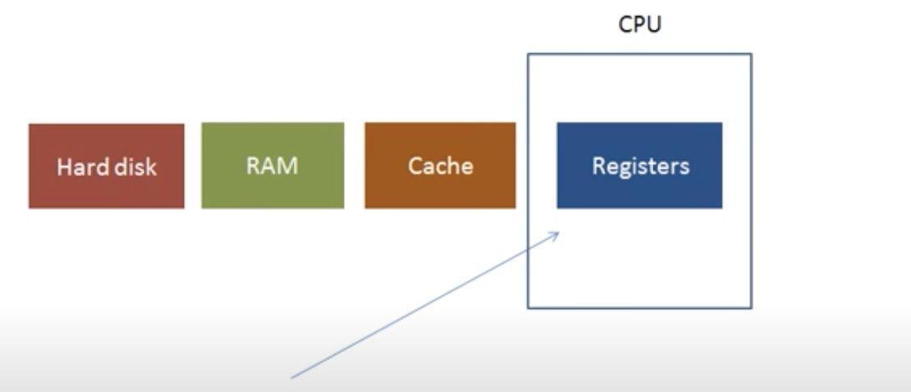
Memory

Slide 6
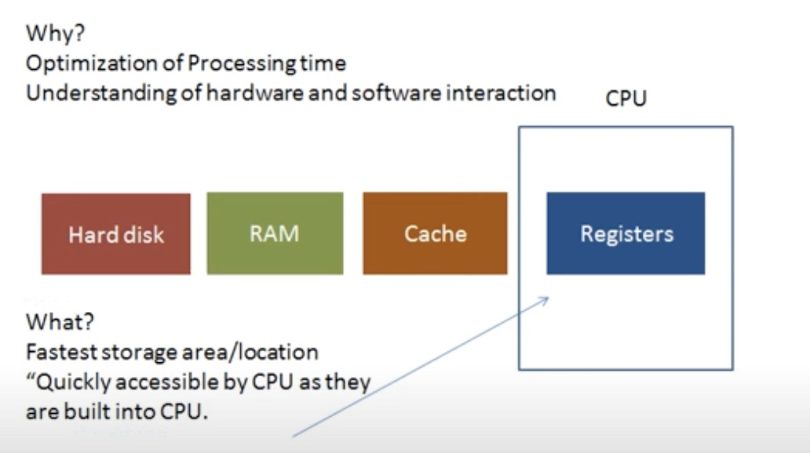
Memory

Slide 7
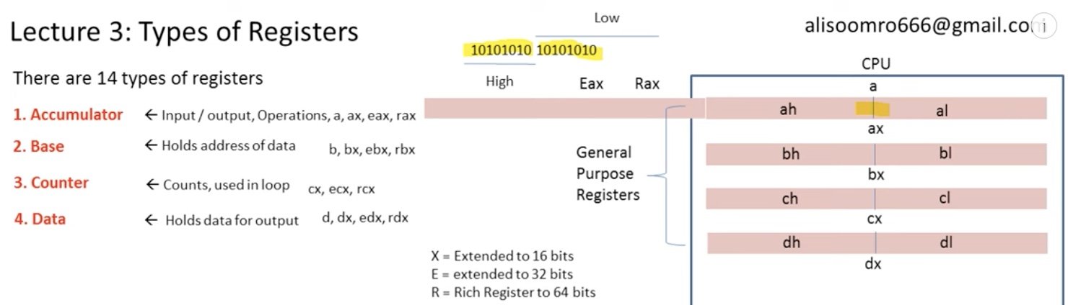
Types of Registers
There are 14 types of registers:
1) General Purpose Registers

Slide 8
Types of Registers
There are 14 types of registers:
1.) General Purpose Registers

Slide 9
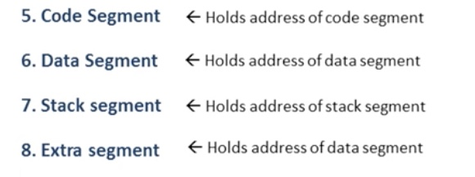
Types of Registers
There are 14 types of registers:
2.) Segment Regisers

Slide 10
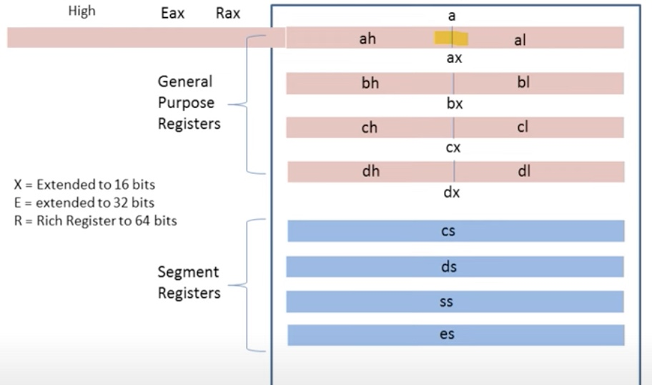
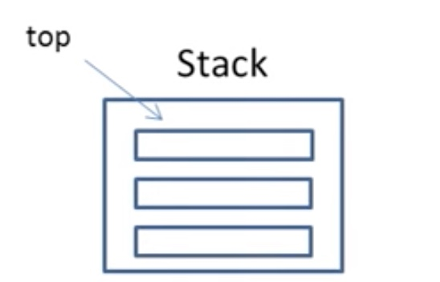
Types of Registers
There are 14 types of registers:
2.) Segment Regisers

Slide 11
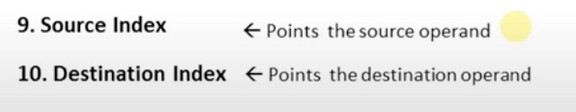
Types of Registers
There are 14 types of registers:
3.) Index Regisers

Slide 12
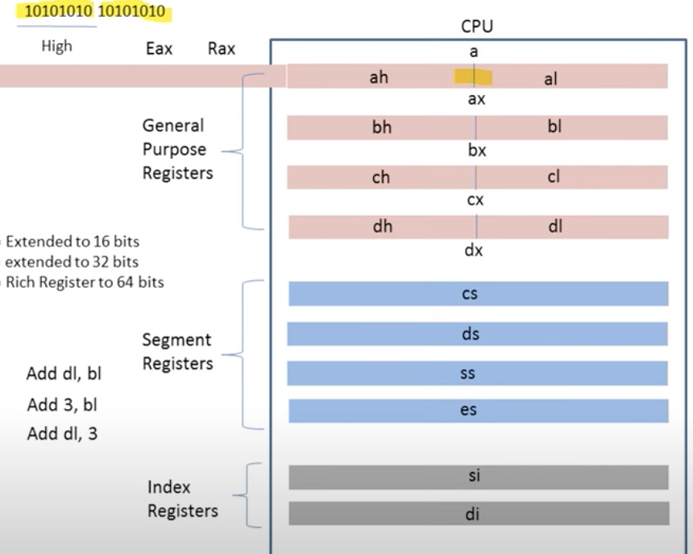
Index Registers

Slide 13
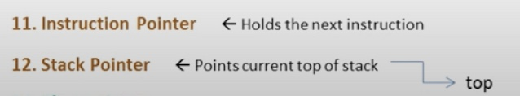
Types of Registers
There are 14 types of registers:
4.) Special Purpose Regisers

Slide 14
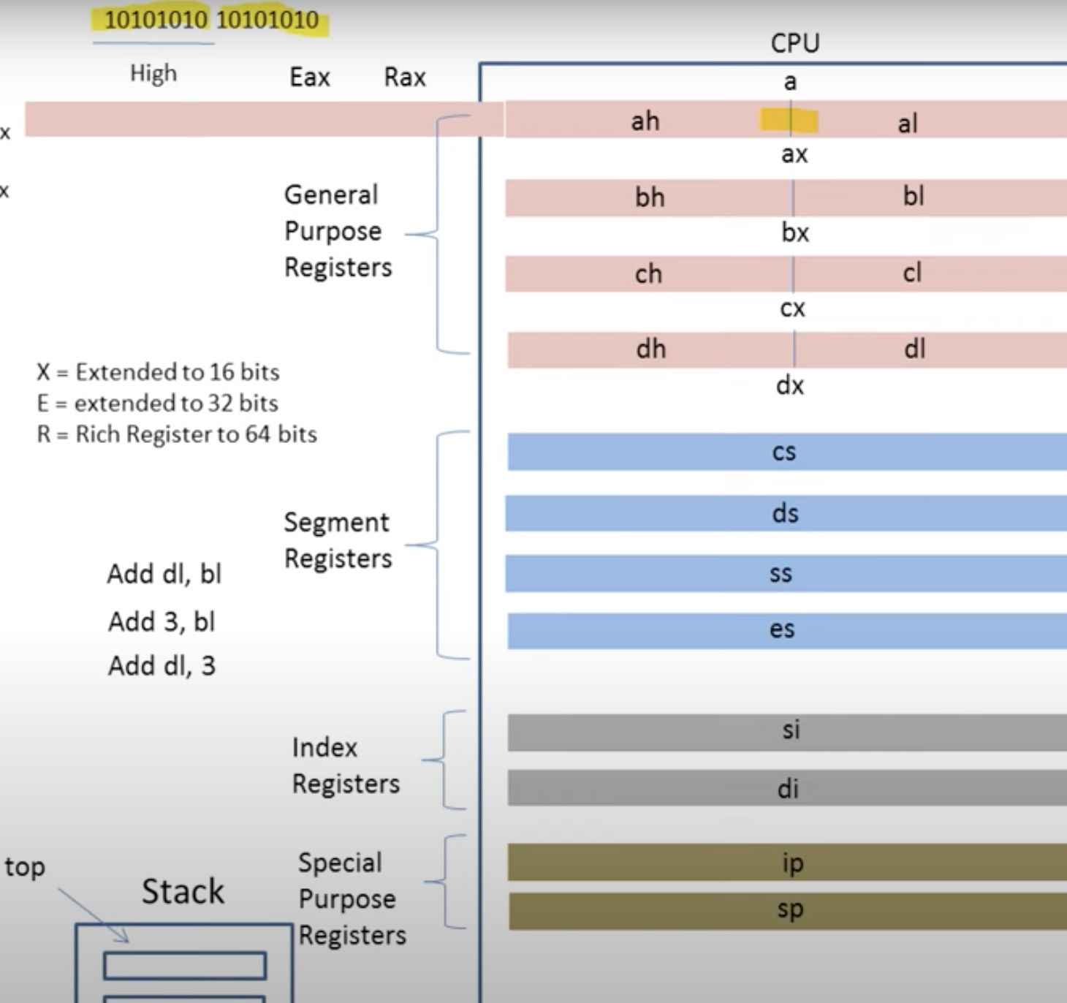
Special Purpose Registers

Slide 15

Types of Registers
There are 14 types of registers:
5.) Flag Regiser

Slide 16
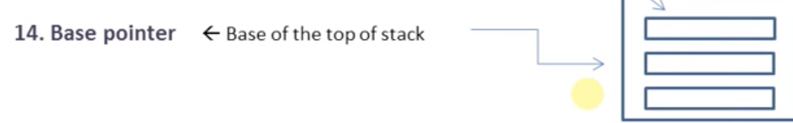
Types of Registers
There are 14 types of registers:
6.) Base Pointer

Slide 17
Reminder !
Quiz 1 in next class (Syallbus is from lecture 1 to lecture 3)

Slide 18
End of Lecture

